Slide 1
Explainable Artificial Intelligence
(XAI)

Slide 2
Lets agree to disagree…
‘Machine Learning’:
The sub-field of AI that studies methods that allow computers to inductively learn from data and improve predictions based on that data…
To ‘Learn’:
To construct a descriptive and predictive model of a specific phenomenon…
To ‘Inductively learn’:
To construct a model by generalizing the information detected in some examples of the phenomenon…

Slide 3
The current state of affairs…
Intense use of AI in all areas of human activity…
Science, Engineering, Arts, Education, Social, Entertainment, etc…
Three levels of usage:
Collect information to support decision-making processes…
Make decisions (act accordingly)…
Perform activities with high level of abstraction:
Planning, Communication, Strategy and Security
Almost no activity oriented towards General Artificial Intelligence…

Slide 4
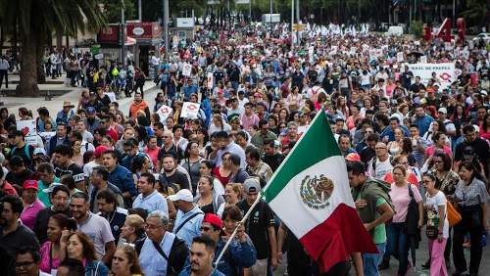


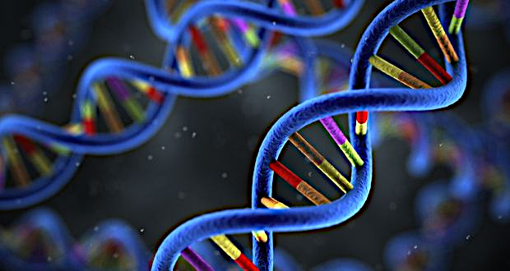
The current state of affairs…
Many scientific disciplines are changing from qualitative to quantitative methods and also towards machine learning…
Biology
Genomics
Sociology
Psicology

Slide 5
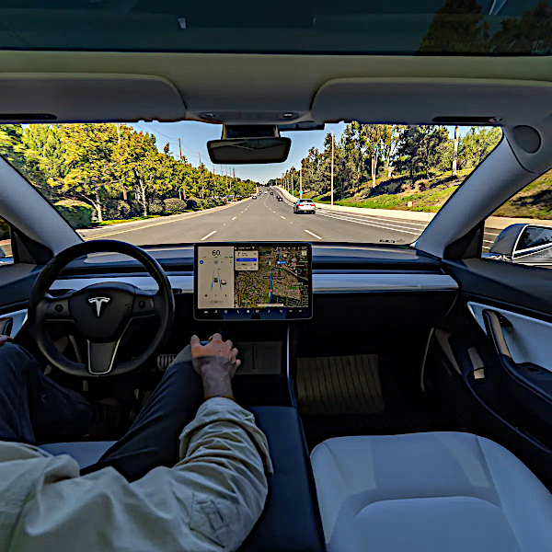
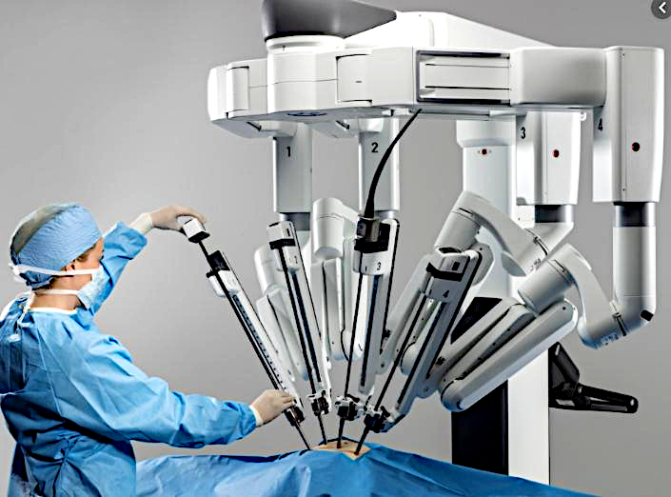



Can we trust ?
Can people trust AI if they don’t know how it works ?

Slide 6
Need for trust in AI systems…
Consumers want reassurance about its safe and ethical use…
Business want to mitigate the risk of unintended consequences…
Citizens need to trust in the fairness and justice of the decisions and actions taken…
Governments need to clarify, if something goes wrong,
Who is accountable for ?
How to explain what exactly went wrong?…
What kind of meassures can be taken to prevent it in the future ?

Slide 7
What is XAI ?
XAI is an emergent field that focuses on different techniques to break the black-box nature of AI procedures (particularly those from machine learning) and produce human-level explanations…
Classic AI (symbolic)
Cognitive AI (connectionist)
Data Science (statistic/probabilistic)
Natural Language Processing (hybrid)
…

Slide 8
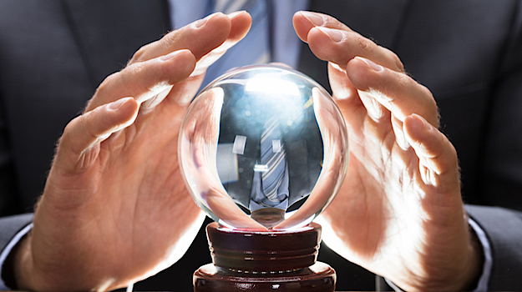
Break the black-box nature…
When a model is no longer a black-box then it has been given interpretability and/or explainability…
Decisions based on learned models, pattern-recognition, and prediction are the ones that most require an explanation…
In some cases, even novice-level or beginner-level explanations are required…

Slide 9





When using a predictive model…
WHAT is predicted…
WHY is the prediction needed…
HOW was the conclusion reached…
What data is used to predict ?
How is the prediction used to make decisions ?
Consequences of a wrong prediction…
Consequences of a wrong decision…

Slide 10


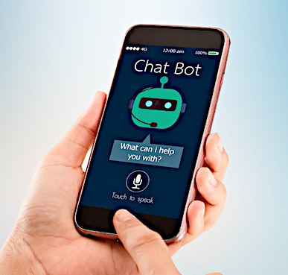


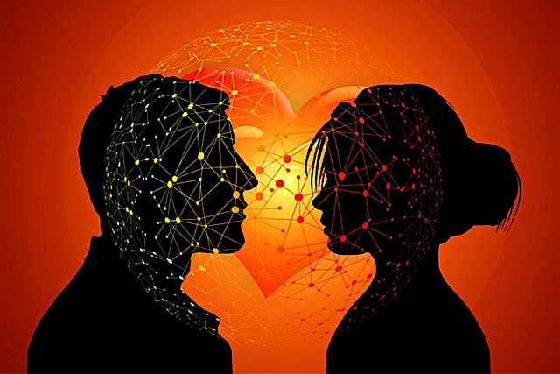


Low Risk environments…

Slide 11
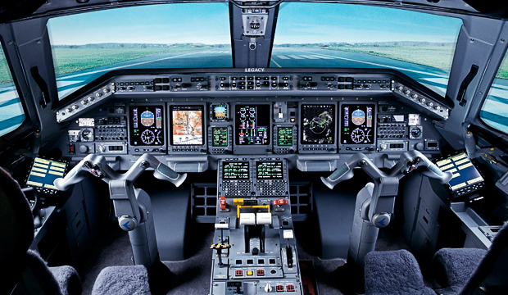

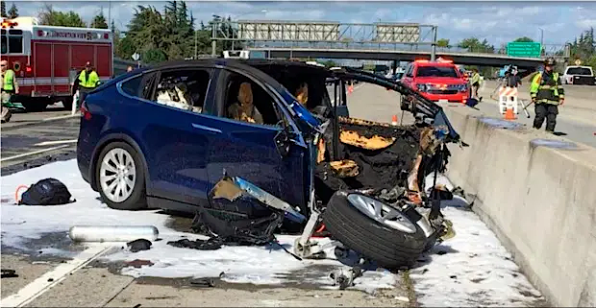
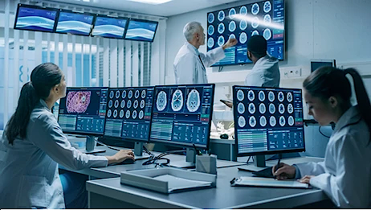
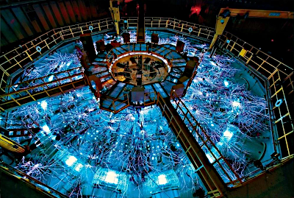
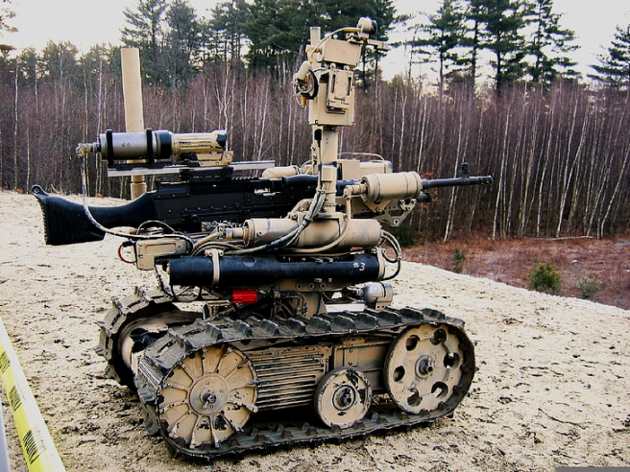
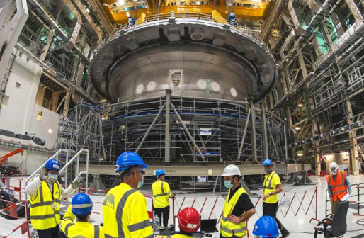
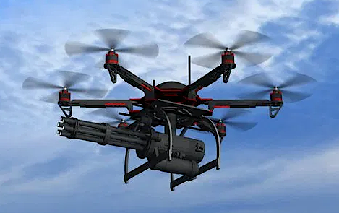
High Risk environments…

Slide 12
Potencial benefits…
If a machine learning model can explain its results, then it can help to ensure:
Fairness of the model (detect learning bias)…
Privacy of sensitive information…
Robustness of the input-output relation…
Causality of the learned model…
Trust & acceptance of the use of the model…

Slide 13
But … what is interpretability ?
Currently, there is no mathematical definition of interpretability…
« Interpretability is the degree to which a human can understand the cause of a decision, and/or consistently predict the model’s result »
Miller, Tim.
"Explanation in artificial intelligence: Insights from the social sciences."
arXiv Preprint arXiv:1706.07269. (2017)

Slide 14
What is an explanation ?
An explanation is the answer to a WHY-question…
HOW-questions can be usually be rephrased as a WHY-question or answered by an algorithmic description…
Human explanations are usually…
Contrastive…
Socially sensitive…
Selected…
Verifiable…
Focused on the abnormal…

Slide 15

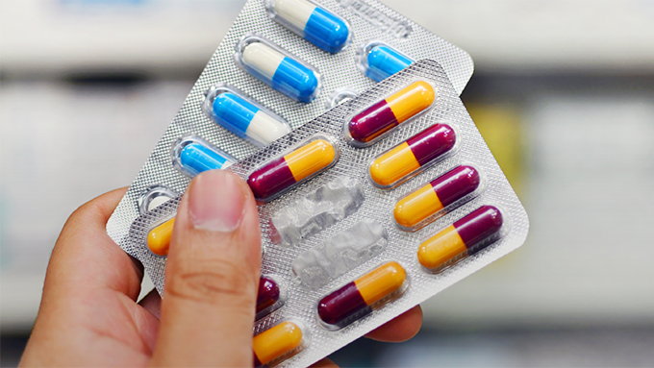

Properties…
Explanations are usually CONTRASTIVE…
Why this result was reached instead of another possible result ?
Humans tend to think in counterfactual cases…
Notes:
Cómo pudo haber sido diferente el resultado al llenar mi solicitud?
Por qué falló ese específico componente de mi auto?

Slide 16
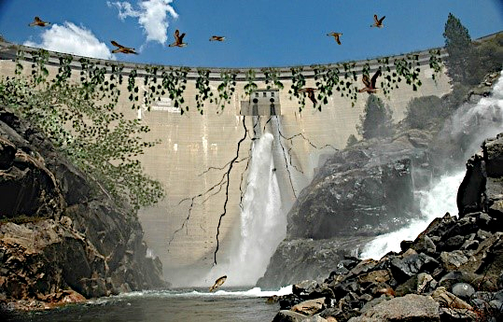
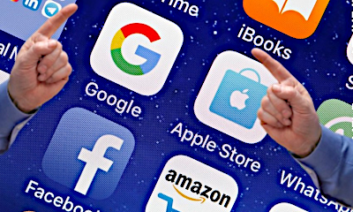

Properties…
Explanations are SELECTED…
Users don’t want a list of all possible causes of an event…
They want the specific cause of a particular result…

Slide 17
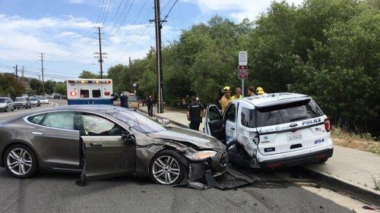
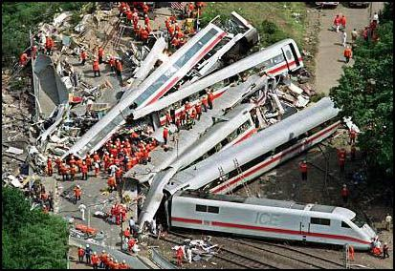

Properties…
Explanations are foucsed on the ABNORMAL…
People seek abnormal causes for unexpected results…
Although with very low probabilities, these circumstances can happen…

Slide 18
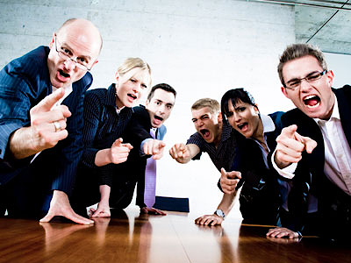


Properties…
Explanations are SOCIALLY SENSITIVE…
The social context of agents determines the nature and complexity of the explanations…

Slide 19

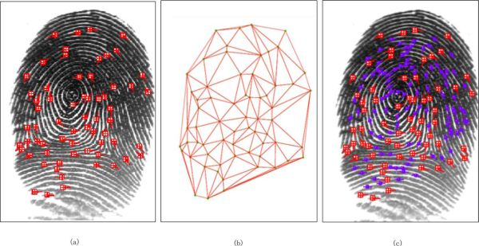
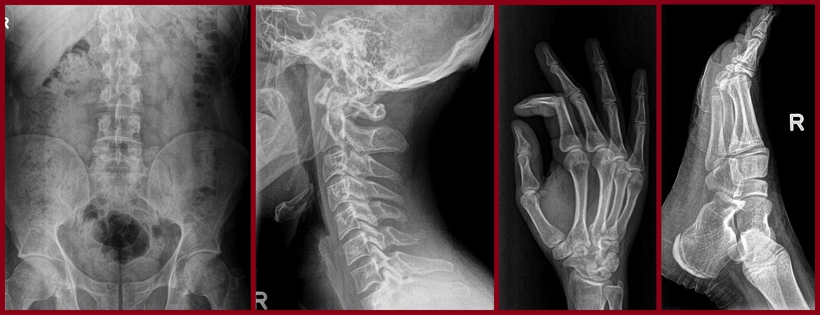
Properties…
Explanations are VERIFIABLE…
There is a difference between ‘intuitive’, ‘strong evidence’ and ‘verifiable’…

Slide 20
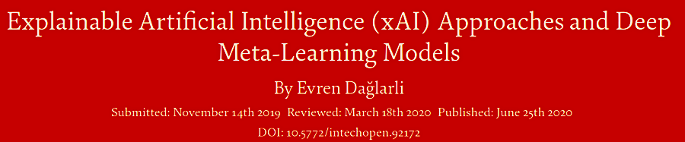

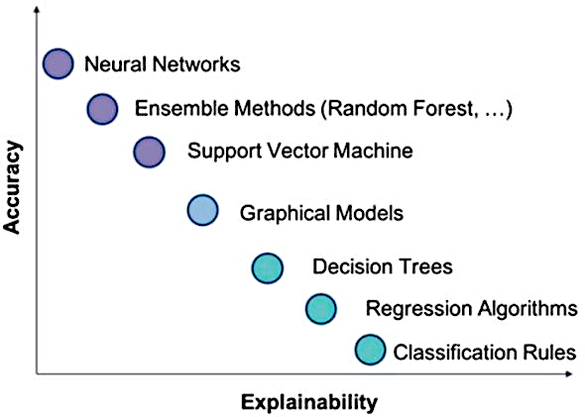
https://www.intechopen.com/books/advances-and-applications-in-deep-learning/
explainable-artificial-intelligence-xai-approaches-and-deep-meta-learning-models

Slide 21
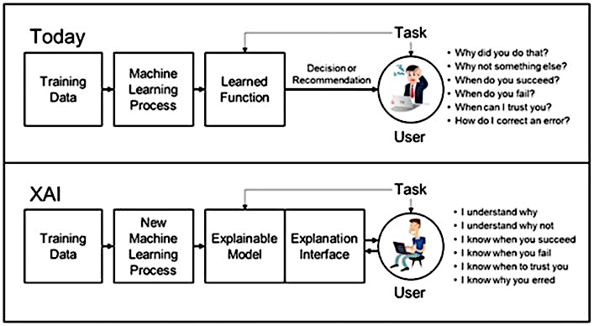
https://www.intechopen.com/books/advances-and-applications-in-deep-learning/
explainable-artificial-intelligence-xai-approaches-and-deep-meta-learning-models

Slide 22

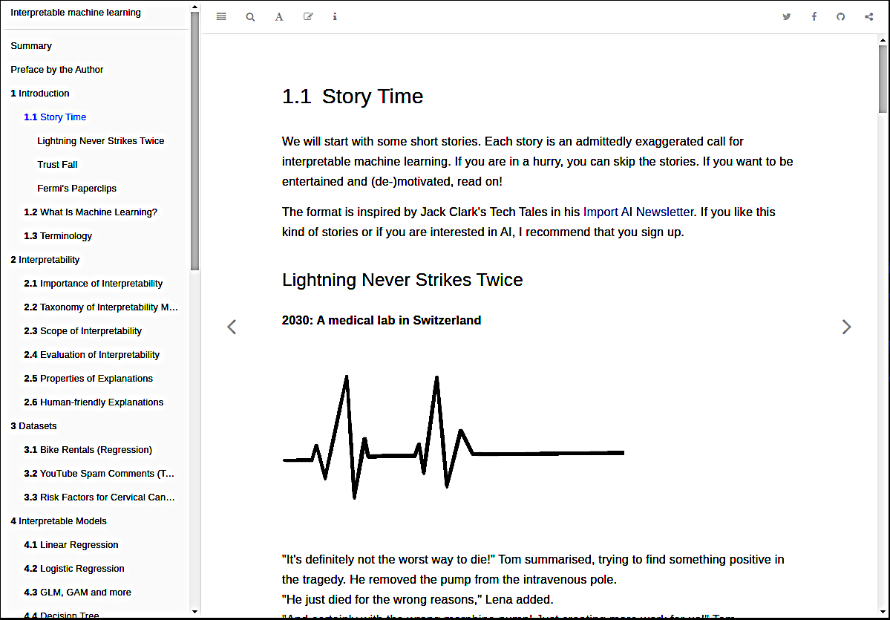
A first step…
Interpretable Machine Learning
A Guide for Making Black Box Models Explainable.
Christoph Molnar
2021-06-14
https://christophm.github.io/interpretable-ml-book/

Slide 23
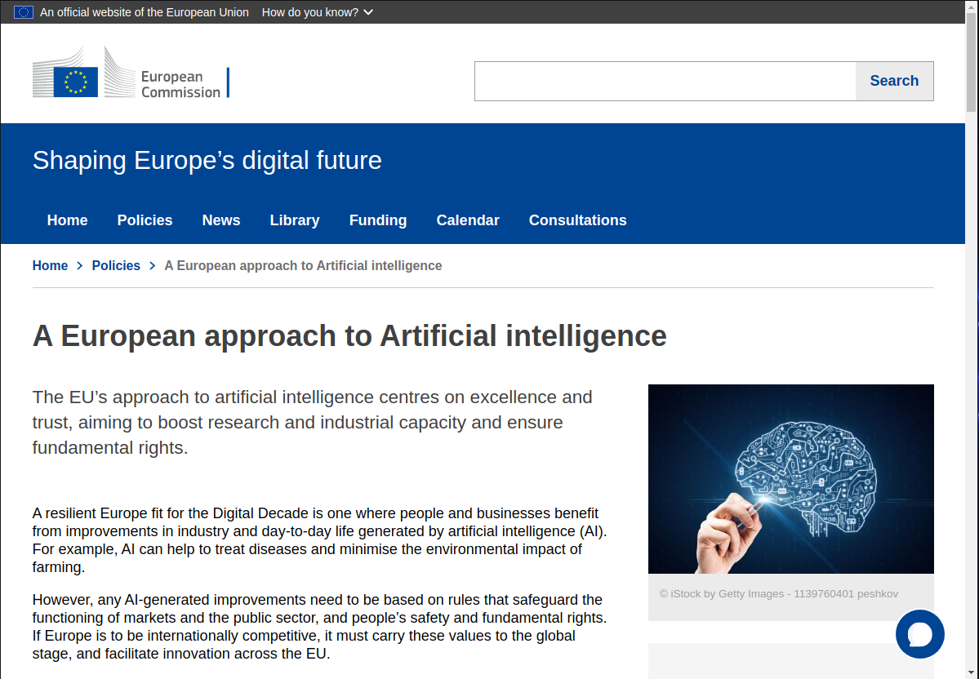
The European Commission…
https://digital-strategy.ec.europa.eu/en/policies/european-approach-artificial-intelligence

Slide 24
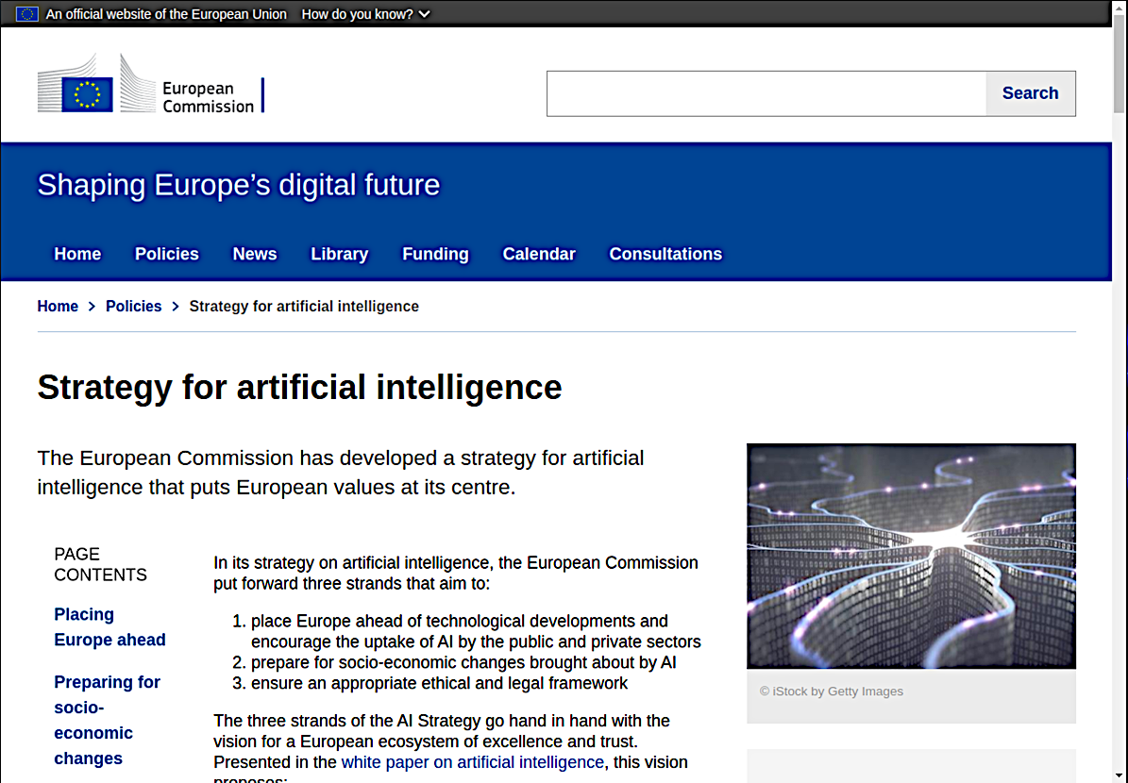
The European Commission…
https://digital-strategy.ec.europa.eu/en/policies/strategy-artificial-intelligence

Slide 25
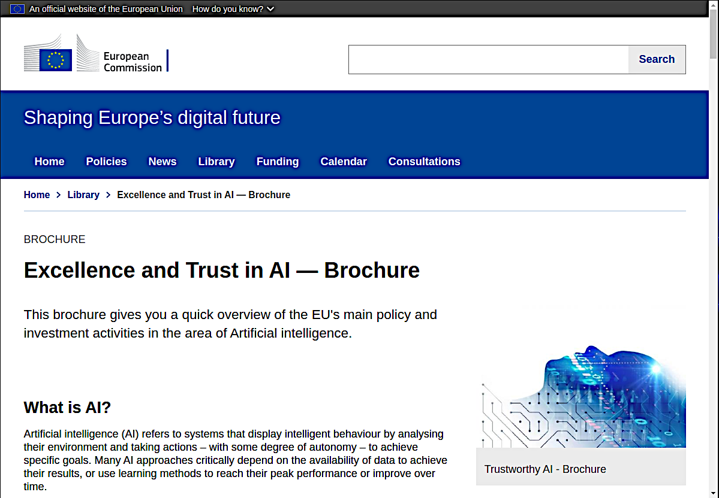
The European Commission…
https://digital-strategy.ec.europa.eu/en/library/excellence-and-trust-ai-brochure

Slide 26
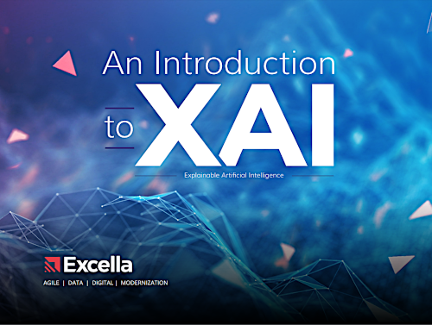
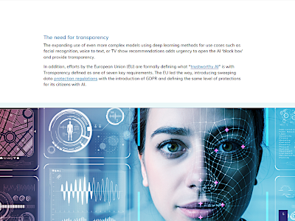
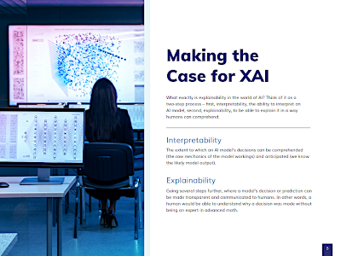
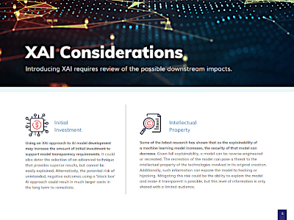
The business viewpoint…
https://www.excella.com/wp-content/uploads/2020/04/Excella_XAI-eBook.pdf

Slide 27
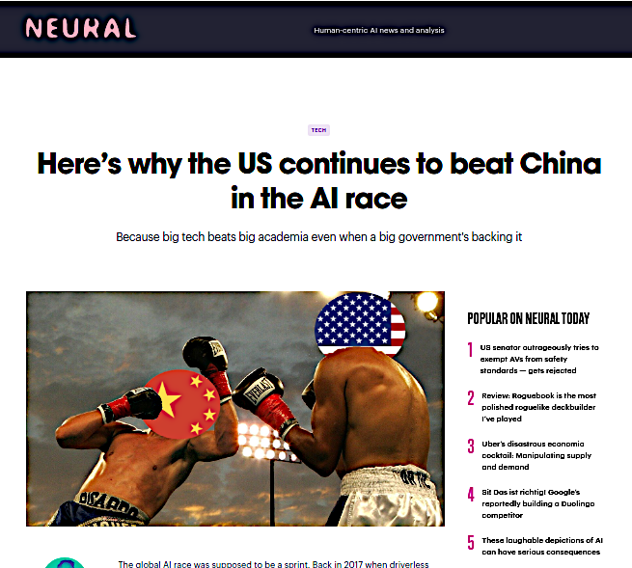
An interesting idea…
https://thenextweb.com/news/heres-why-the-us-continues-to-beat-china-in-the-ai-race

Slide 28
The arguments…
In EU and US companies are the primary holders of AI patents, in China, the majority of AI patents are filed by government owned universities and research institutes…
The biggest AI problem China is a lack of innovation, 90% of China’s AI development is based on unexplained deep-learning…
Tech companies in the US can afford to invest in breakthrough research even if it fails, while most Chinese firms are driven by the incentive of profit…

Slide 29

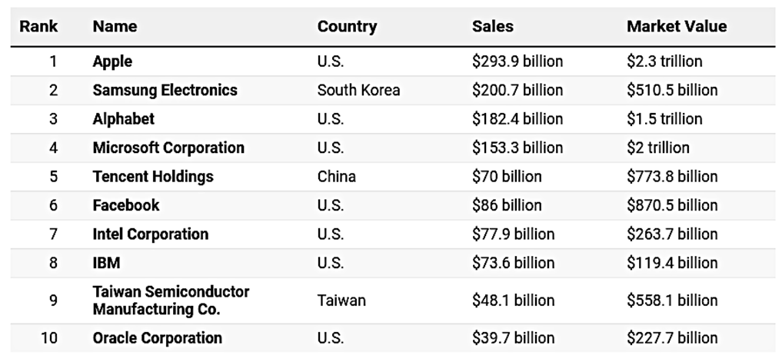
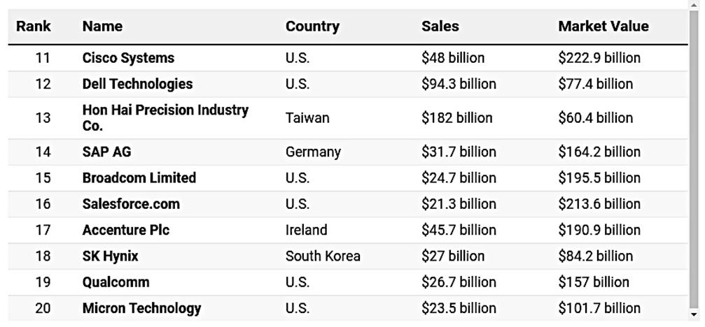
https://www.forbes.com/sites/jonathanponciano/2021/05/13/worlds-largest-tech-companies-2021/?sh=527c9b6769bc

Slide 30
Conclusions…
The global success of AI does not depend solely on scientific and technological advances. To a large extent, it also depends on social acceptance, as well as the policies and laws for its use.
Drastically separating science from engineering, psychology or politics only makes the problem worse...
As AI professionals, it is in our best interest to promote the daily use of explanations…

Slide 31
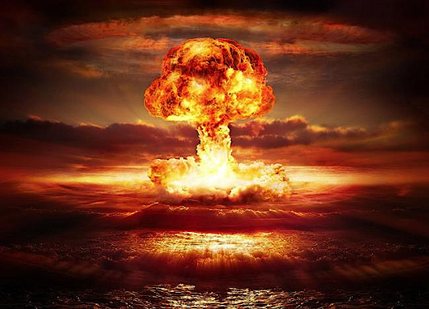
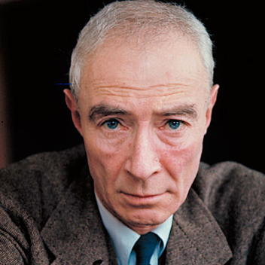
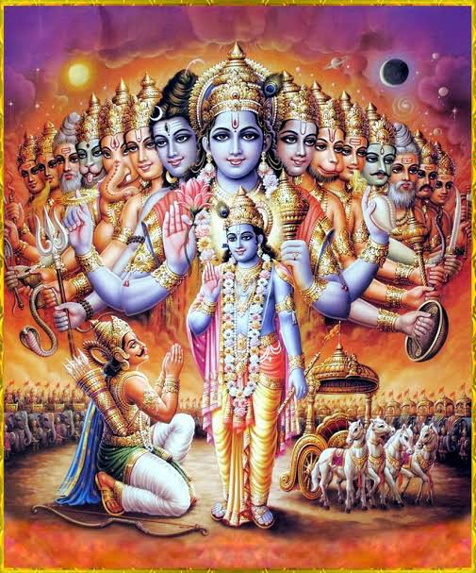
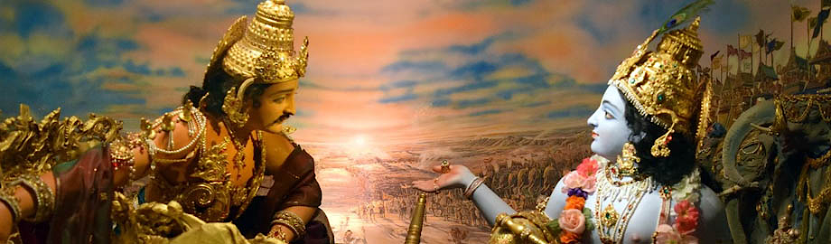
'Now I have become Death,
the destroyer of worlds…'
Robert Oppenheimer
(1904 - 1967)
700-verse Hindu sacred text
the Bhagavad-Gita
Verse 12 - Prince Arjuna & Lord Krishna

Slide 32
Thank you !

